Slide 1
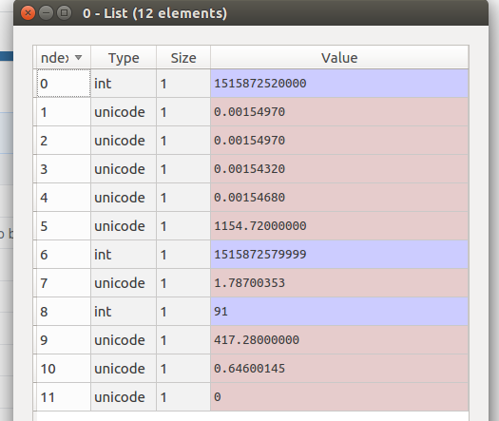
Notes/Data
Klines:
get_historical_klines(symbol, interval, start_str, end_str=None)[source]
Get Historical Klines from Binance
See dateparse docs for valid start and end string formats http://dateparser.readthedocs.io/en/latest/
If using offset strings for dates add “UTC” to date string e.g. “now UTC”, “11 hours ago UTC”
Parameters:
symbol (str) – Name of symbol pair e.g BNBBTC
interval (str) – Biannce Kline interval
start_str (str) – Start date string in UTC format
end_str (str) – optional - end date string in UTC format
Returns:
list of OHLCV values
OHLCV = Open, High,Low, Close, Volume
0 – Start of reporting period (unix Timestamp, in millis)
1- Open Price
2 – High Price
3 – Low Price
4 – Close Price
5 – Volume
6 – End of reporting Period (unix Timestamp, in millis)
7 -
8 -
9 -
10 -
11 -
TIMESTAMP
A normal unix timestamp is in seconds, so if this is to be converted to datetime then it needs to be divided by 1000

Slide 2
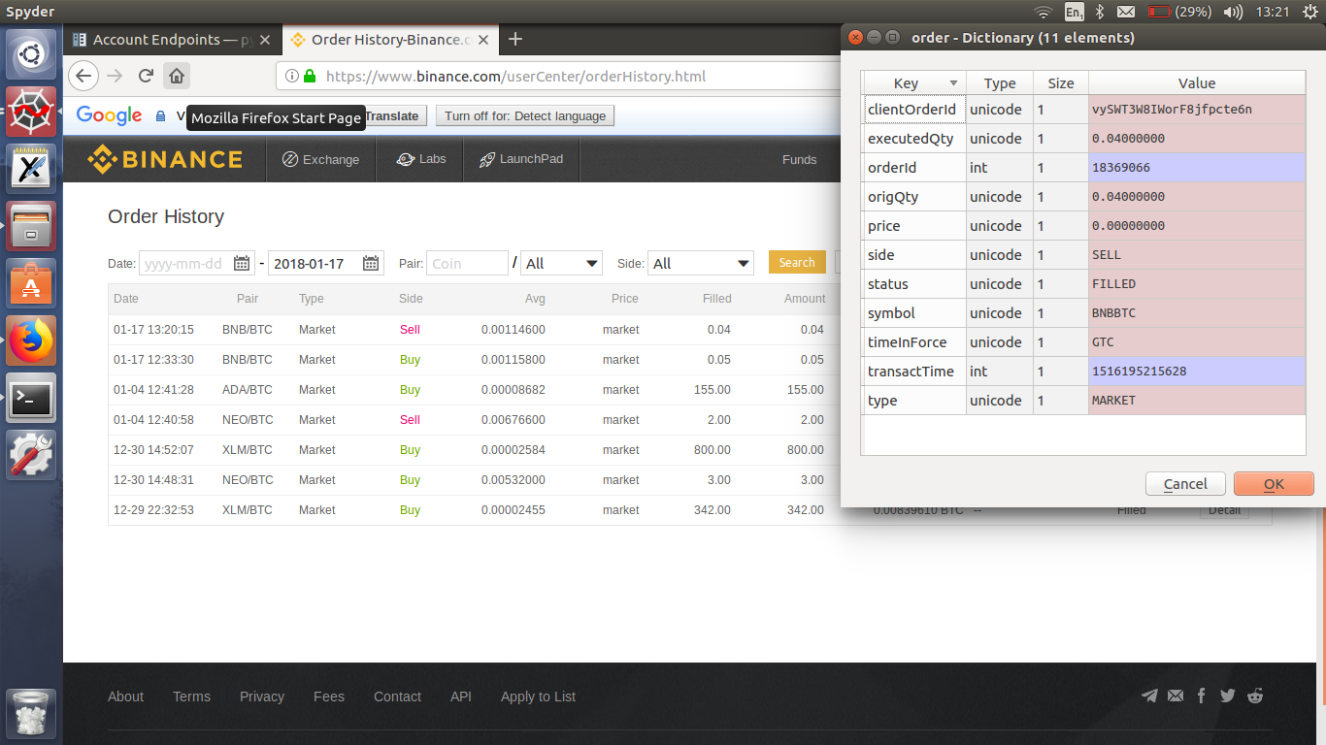
Output of the trade command
This is the default output

Slide 3
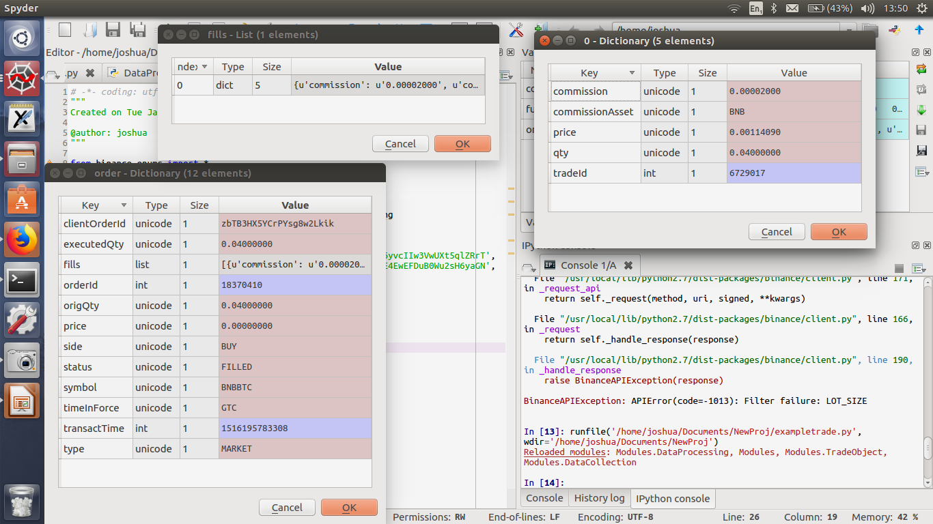

Slide 4
Naming convention
BNBBTC means you are buying and selling BNB, using your BTC.
This convention is true of all tickers

